Slide 1

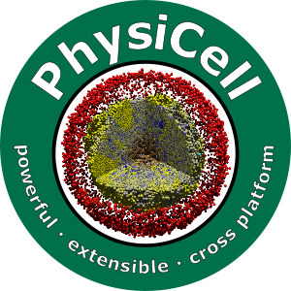

Session 11: Intracellular Modeling
Slides, videos, links and more:
https://github.com/physicell-training/ws2021
Furkan Kurtoglu
@FKurtogluSysBio
July 28, 2021

Slide 2
What we have learned so far
PhysiCell folder structure
PhysiCell model domain
Different dts (diffusion_dt, mechanic_dt, phenotype_dt)
Using GUI to create config file (XML)
PhysiCell C++ functions

Slide 3
What we will learn
Basics of Kinetic Modeling (ODE Model)
How to integrate kinetic models to ABM
How to control phenotype based on intracellular model
Kinetic ODE solver (libRR) related functions
How to save intracellular data
How to make faster your simulation with losing convergence

Slide 4
Agenda:
First Session
PhysiCell 1.9.0
Kinetic SBML
PhysiCell Integration
Model Design
Results
Convergence Tests
libRR Add-on
Functions
Phenotypic Changes
Sample Model
Description
Basic Domain Creation (If we can)

Slide 5
PhysiCell 1.9.0
PhysiCell 1.9.0
Released: 12 July 2021
Major new features
Includes three intracellular modeling approaches
Boolean Network => PhysiBoSS
Kinetic Modeling (ODEs) => libroadrunner
Flux Balance Analysis => PhysidFBA
New Intracellular Object in Phenotype
All intracellular packages basic generic functions with same syntax
Start(), Update(), get_parameter(), set_parameter(), …
Some special functions specific to packages
get_boolean_variable_value(PhysiBoSS) validate_SBML_species (ODE), …

Slide 6
3 Sample Projects
PhysiBoSS
physiboss-cell-lines-sample
Libroadrunner
ode-sample-project
PhysidFBA
cancer-metabolism

Slide 7
Installation
Each add-on requires related solver
PhysiBoSS – MaBoSS
PhysidFBA – coin-clp
Libroadrunner – Libroadrunner (no surprise!)
To install related solver, you need to populate sample-project, first
make ode-energy-sample
Then, compile once.
make

Slide 8
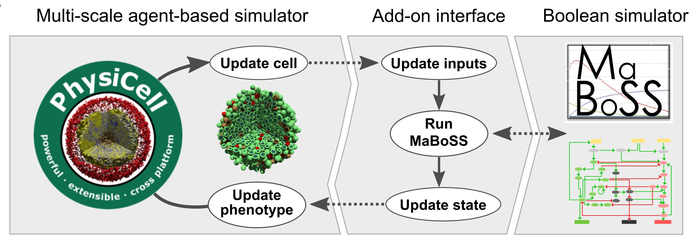
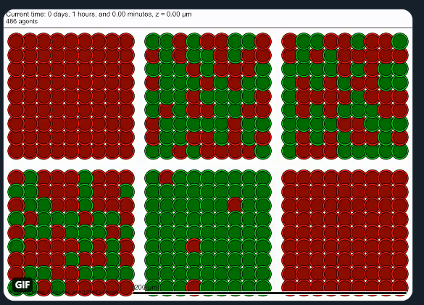
PhysiBoSS
Boolean Network
MaBoSS
SysBioCurie & BSC
https://github.com/gletort/PhysiBoSS
Fully integrated as “add-on” to PhysiCell
We had an optional morning session
Please visit agenda for slides and video

Slide 9
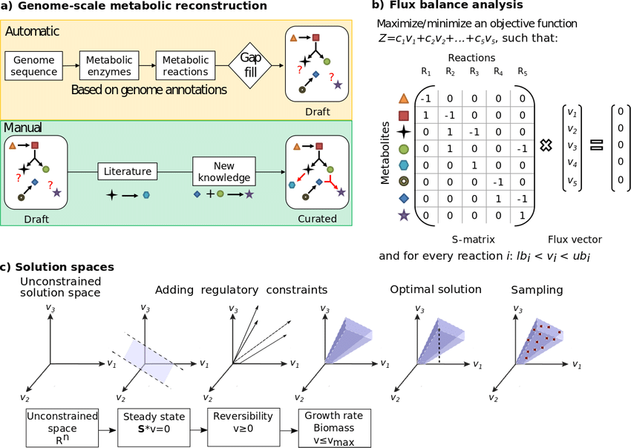
PhysidFBA
Aims to couple ABM and FBA.
Miguel Ponce de Leon
Approach will be explained in future slides.
https://github.com/migp11/PhysiCelldFBA
Added alpha version as “add-on” to PhysiCell.
Heirendt et al, 2017

Slide 10
Libroadrunner
Integrating intracellular kinetic models to individual agents.
Individual phenotype changes according to molecular simulations
Intracellular values (Molecular Concentrations, Signal Transductions, i.e.)
Intracellular oxygen deficiency in cell leads to change necrosis rate.
Intracellular amino acids levels define the cellular growth / cycle rate.
Opens new opportunities for PhysiCell syntax
Users can utilize SBML to model phenotypic behaviors.
Since molecular values can edit phenotypic parameters in SBML, PhysiCell interface is getting changed.
LibRR is developed by
Herbert Sauro and Andy Somogyi
C++ API

Slide 11
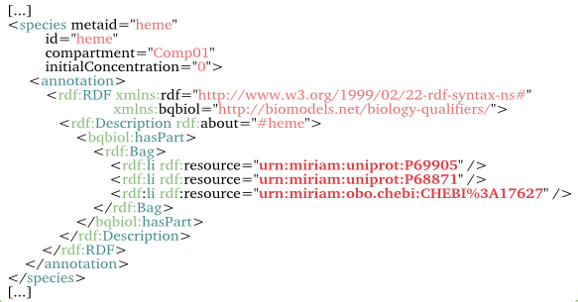
SBML
Systems Biology Mark-up Language
Reaction – Stoichiometry
Kinetic – Pseudo Steady State
Kinetic – Ordinary Differential Equations
Pseudo Steady State – Optimization (Flux Balance Analysis)
Hard to read for Human (xml file)
Parsed according to some rules.

Slide 12
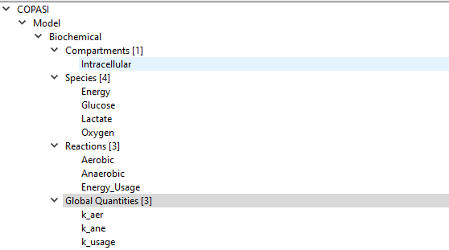
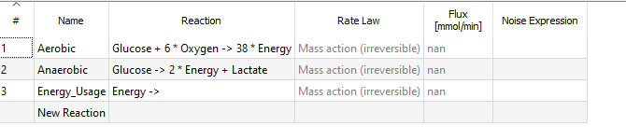
SBML
Compartments
Volumetric Entities
Species
Chemicals
Reactions
Stoichiometric Relations
Boundaries (Lower and Upper) (FBA)
Global Quantities
Parameters
Constants

Slide 13
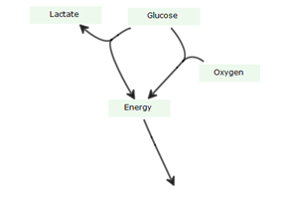
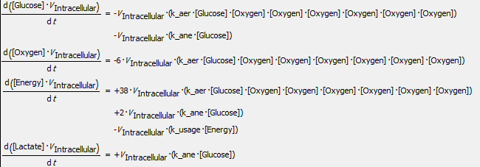
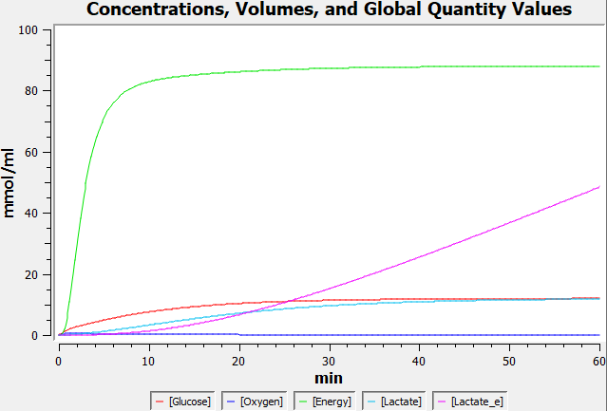
Kinetic Modeling

Slide 14
SBML
General SBMLs have more than one compartment
Extracellular
Intracellular
Mitochondria (Sometimes)
Nucleus (?)
And have two or more species for one substrate
Glucose[e] => extracellular
Glucose[i] => intracellular
Transfer reaction between compartments
Glucose[e] = Glucose[i]

Slide 15
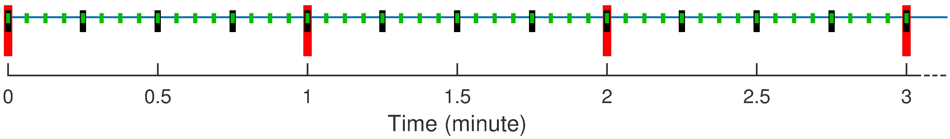
Assumptions
But …
PhysiCell has transfer reactions through
BioFVM
So, we can support specific type of SBMLs
Only Intracellular (might have more than one compartment – Mitochondria, Nucleus)
Well-Structured SBMLs
Not all SBMLs are supported!!!
No External Compartment and Transfer Reactions in SBML!
Mapping is needed between SBML & PhysiCell
Works on each diffusion_dt (0.01 min)
(as default for best convergence)

Slide 16

Integration Design
Updating SBML Model
SBML Model
Microenvironment
Cellular Data
Kinetic Simulation
1
3
Uptake/Secrete
Internal Metabolites
Amount
Libroadrunner
2
4
Divided by Volume
Internal Metabolites
Concentration
BioFVM
3
Updating SBML Model
Phenotypic Parameters
Kinetic Parameters
5
5
PhysiCell
Agent Based Modelling

Slide 17
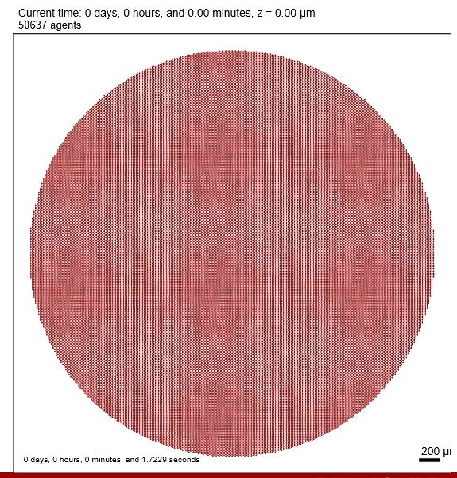
Performance Test
More than 50,000 cells
4 substrate (internalization is on)
5 SBML species (4 reactions)
4000x4000x20 um dimensions (dx = 20 um)
Personal PC
AMD 6 core 3.0 GHz, 16 GB RAM
8-thread, OpenMP
 | 1 min output | 60 min output
No SBML solver | 11 secs | 1 min 57 secs
SBML solver | 20 secs | 16 min 35 secs

Slide 18
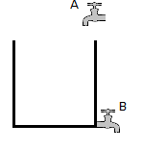
How about intracellular_dt
Default 0.01 min but…
Imagine cell is like pool with source and sink
A = uptaking a chemical from microenvironment
B = secreting a chemical to microenvironment
If diffusion_dt and intracellular_dt is same,
They are matching dt’s so there is no convergence difference.
But it is slow!
(Figure to be drawn during presentation)

Slide 19
How about intracellular_dt
However, we can change intracellular_dt.
Let's assume that we made it 1.00 min (100 times slower)
How it will look like (Figure to be drawn during presentation)
So much faster
You will see in the Demo

Slide 20
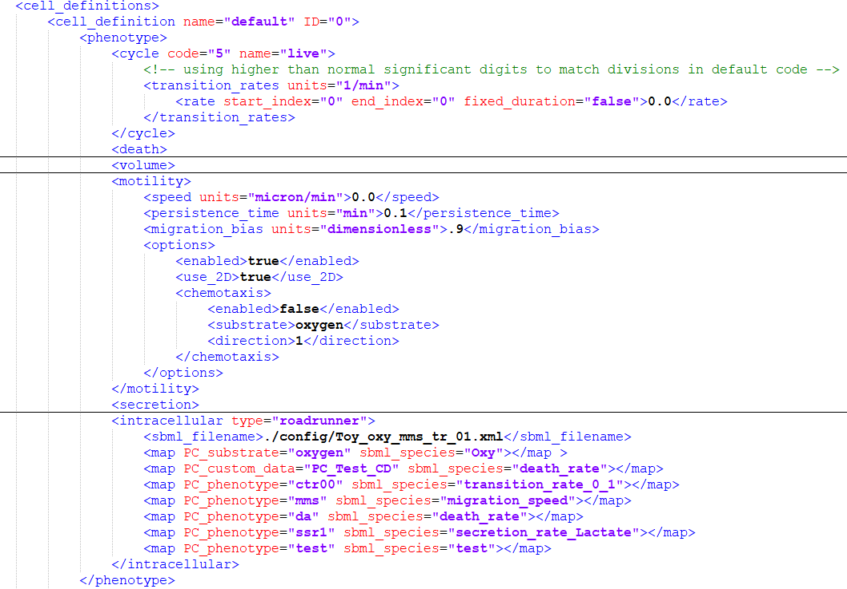
How it looks
Config File

Slide 21
Some Results

Slide 22
Model 0 - SBML Model
4 Species
Oxygen
Glucose
Lactate
Energy
3 Internal Reactions
Aerobic reaction
Glucose + Oxygen -> Energy
Anaerobic reaction
Glucose -> Energy + Lactate
Energy Usage
Energy ->

Slide 23
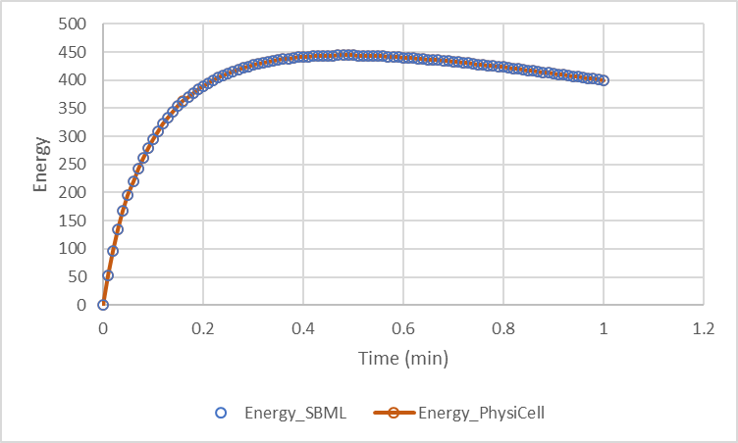
Model 0
Very Simple SBML toy model
Both simulated in PhysiCell and Copasi
No Transfer Reaction in SBML
No Uptake Rate
Only solving SBML

Slide 24
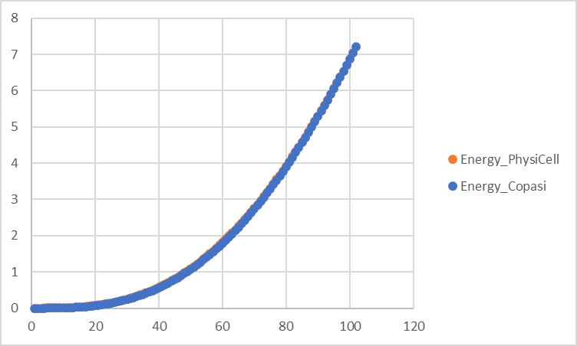
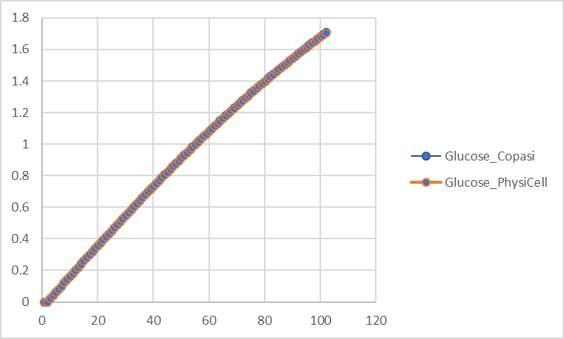
Model 1
Uptake glucose, oxygen
Produces Energy internally.

Slide 25
SBML Events
Cycle Rate
If Energy level is smaller than 50 a.u.
Equals to zero 1/min
If Energy level is greater than 50 a.u.
Equals to 0.01 1/min

Slide 26
Model 2
Phenotypic changes according to SBML species
Organoid (2D) seeding.
Lactate Secretion Rate increases
Lactate Concentration
If oxygen level is less than threshold
Cells increase their migration speed
If Energy level is less than threshold
Cells go apoptosis

Slide 27
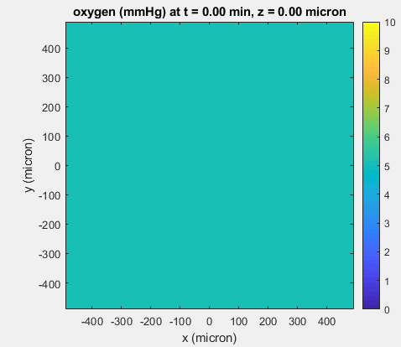
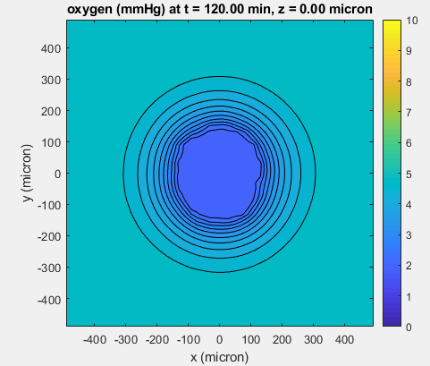
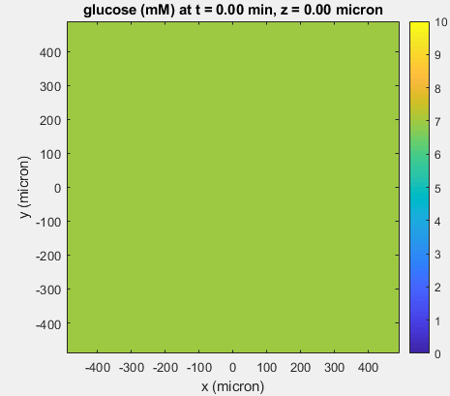
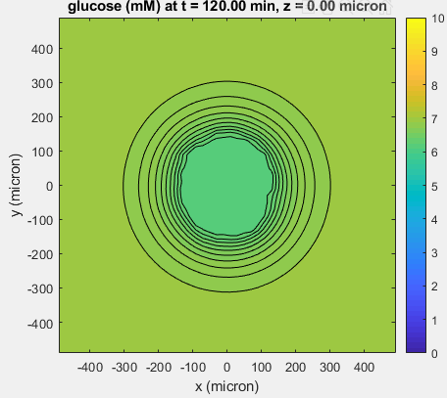
Microenvironment Results

Slide 28
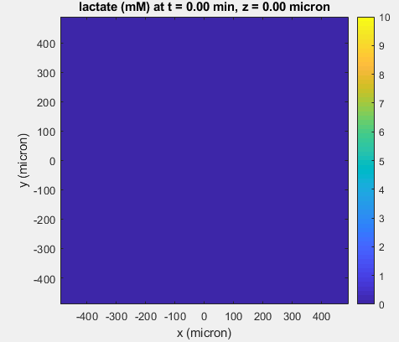
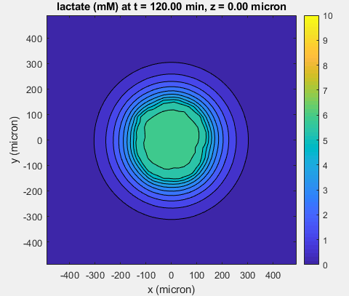
Lactate Secretion

Slide 29
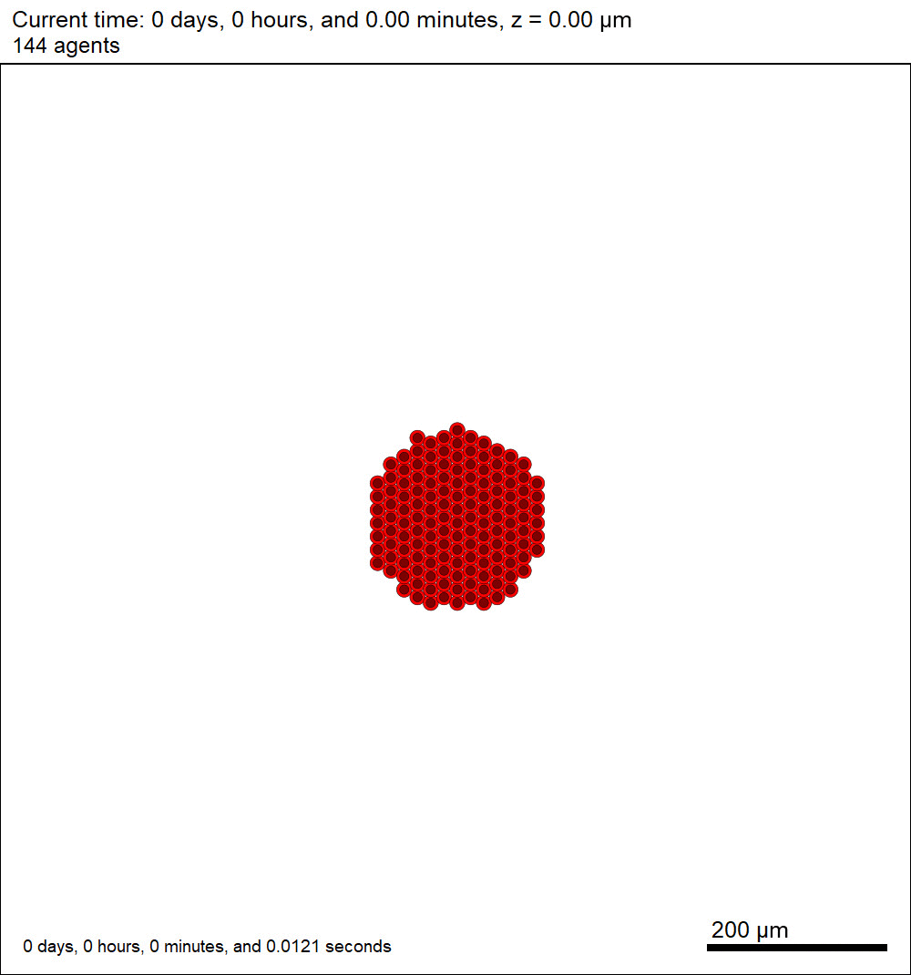

Slide 30
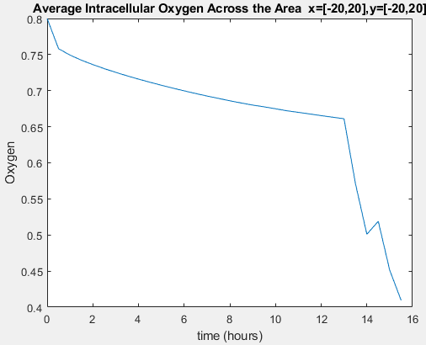
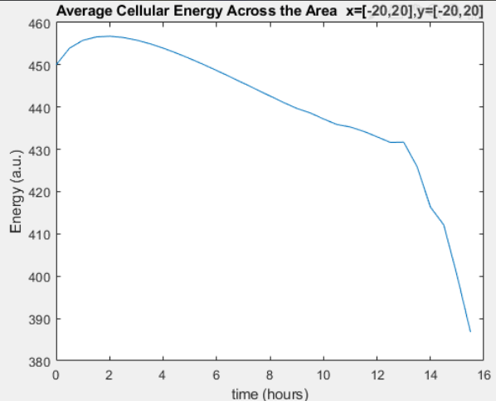
Intracellular

Slide 31
How it looks
Config File

Slide 32
SBML-Phenotypic Parameters
PhysiCell Phenotype Parameter | First letter | phenotype_token | example
Phase Transition Rate | c | ctr_*_* | ctr_0_1
Death Rate | d | da,dn | da,dn
Persistence Time | m | mpt | mpt
Migration Speed | m | mms | mms
Migration Bias | m | mmb | mmb
Uptake rate | s | sur_* | sur_oxygen
Secretion rate | s | ssr_* | ssr_glucose
Saturation density | s | ssd_* | ssd_oxygen
Export rate | s | ser_* | ser_lactate
Target solid cytoplasmic | v | vtsc | vtsc
Target solid nuclear | v | vtsn | vtsn
Target fluid fraction | v | vff | vff

Slide 33
Libroadrunner Addon
Same format for intracellular addons. (PhysiFBA, PhysiBoSS)
Libroadrunner
start() = start intracellular in cell (it should be used after seeding and is called after proliferation)
Initialize_SBML() = to read SBML (users will not use)
get_values() = to get value from SBML
set_values() = to set value in SBML
update() = to simulate SBML
get_state() = to get the name of SBML
update_phenotypic_parameters() = to update phenotype according to given tokens
validate_tokens() = to validate given token
validate_species() = to validate SBML species

Slide 34
Integration Design
Updating SBML Model
SBML Model
Microenvironment
Cellular Data
Kinetic Simulation
1
3
Uptake/Secrete
Internal Metabolites
Amount
Libroadrunner
2
4
Divided by Volume
Internal Metabolites
Concentration
BioFVM
3
Updating SBML Model
Phenotypic Parameters
Kinetic Parameters
5
5
PhysiCell
Agent Based Modelling

Slide 35
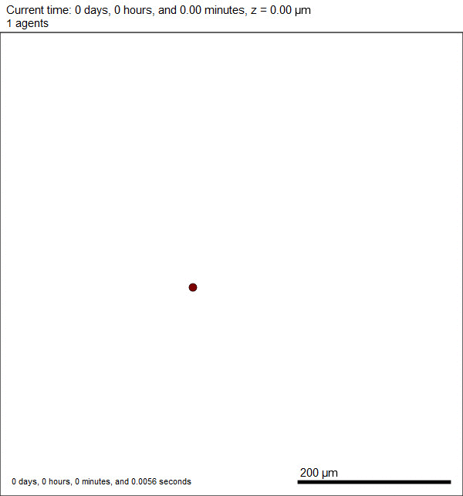
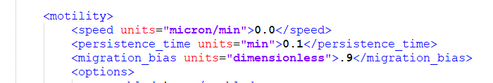
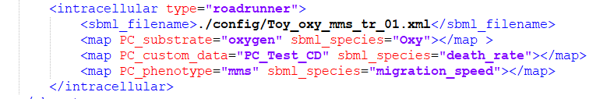
Migration Speed
Cell Definition

Slide 36
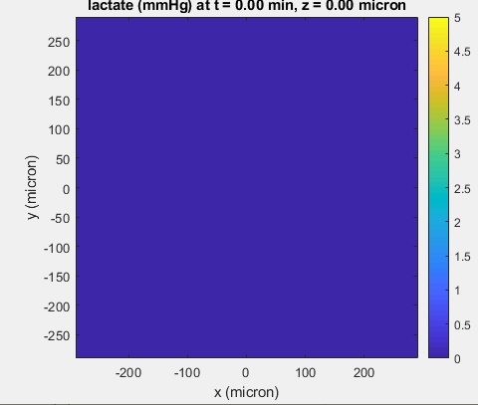
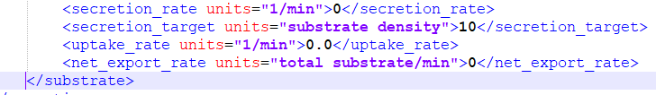
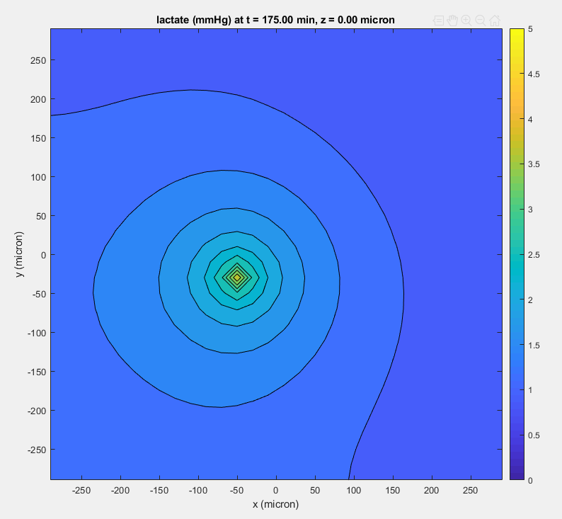
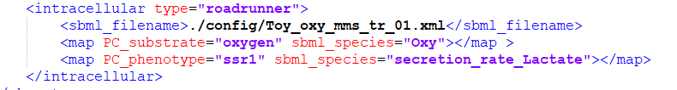
Chemokine Distribution
Cell Definition

Slide 37
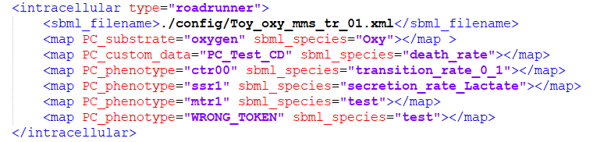
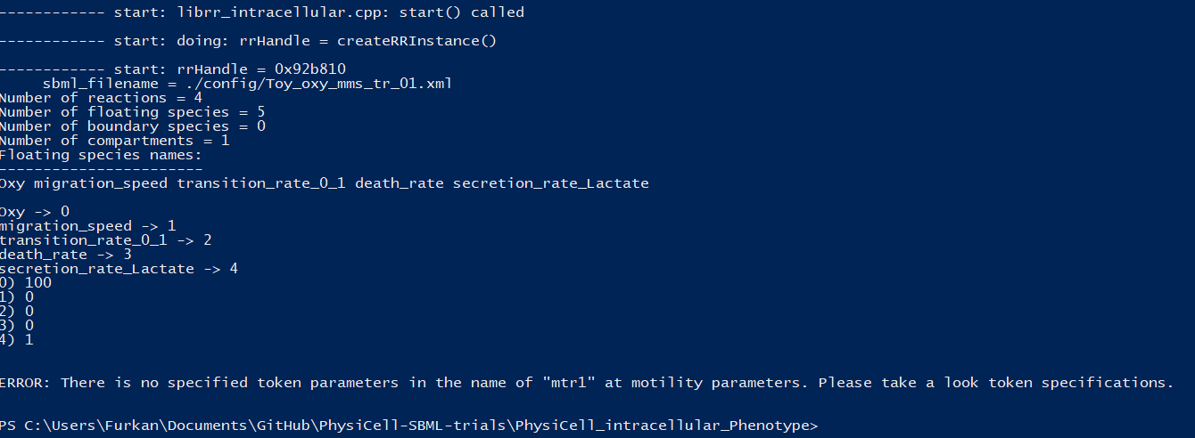
Wrong Tokens

Slide 38
Code walk
Let's do code walk together…

Slide 39
PhysidFBA

Slide 40
Flux Balance Analysis
Heirendt et al, 2017

Slide 41
Integration Design
Updating SBML Model
FBA
Microenvironment
Cellular Data
Optimization
1
2
Uptake/Secrete
Substrate Availability
Coin-clp
3
BioFVM
Cell
Fluid Change Rate
Updating SBML Model
Phenotypic Parameters
5
5
PhysiCell
Agent Based Modelling

Slide 42
PhysidFBA
FBA is like taking a photo
dFBA is like stop-motion video.
dFBA simulates intracellular model
Finds optimal biomass creation flux
This value is used for volume calculation (growth of cell)
If cell is greater than the volume threshold
Divide
Arrest function

Slide 43
LibRoadRunner Interactive Demo

Slide 44
Model
Three Substrates
Oxygen, Glucose, Lactate
Energy is created with two reactions
Glucose + Oxygen -> 38 * Energy (Aerobic)
Glucose -> 4 * Energy + Lactate (Anaerobic)
Energy consumes
Energy -> (Energy_Usage)
Phenotypic Tokens
migration speed, apoptosis_rate, lac_Secretion_Rate, Transition_Rate

Slide 45
Model Rules
Initial Energy = 450
If Energy > 445
Cycle
If Energy < 445
Don’t Cycle
If Energy < 440
Move
If Energy < 430
Die

Slide 46
Populate together
PhysiCell folder
make clean
make data-cleanup
make reset
make list-projects
make ode-energy-sample
make

Slide 47
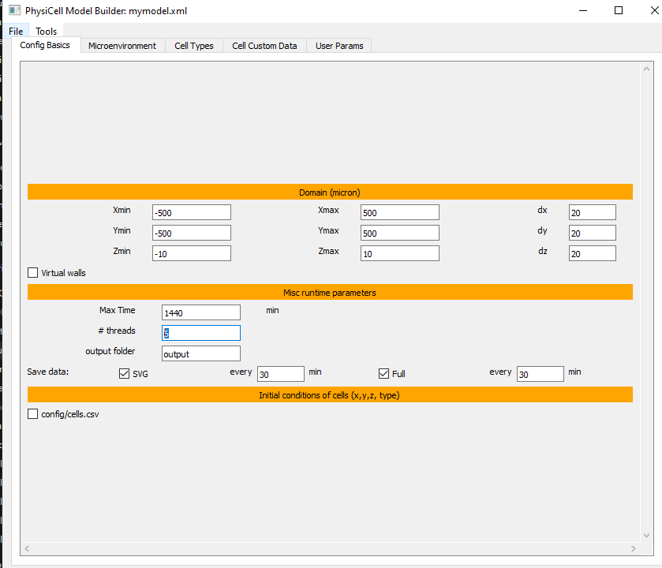
Demo Model
Domain size
X=[-500,500]
Y=[-500,500]
Z=[-10,10]
dx,dy,dz = 20
Use_2D = true
Max-time = 1440 min
Thread = your choice
Save data : SVG = 30 min, Full = 30 min

Slide 48
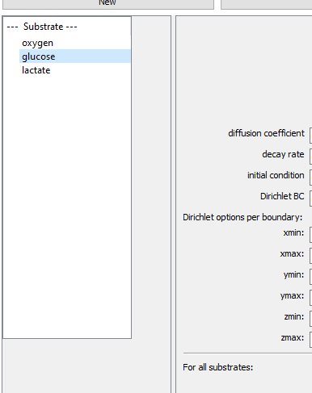
Demo Model
Microenvironment Tab
Let’s add “oxygen”, “glucose”, “lactate”

Slide 49
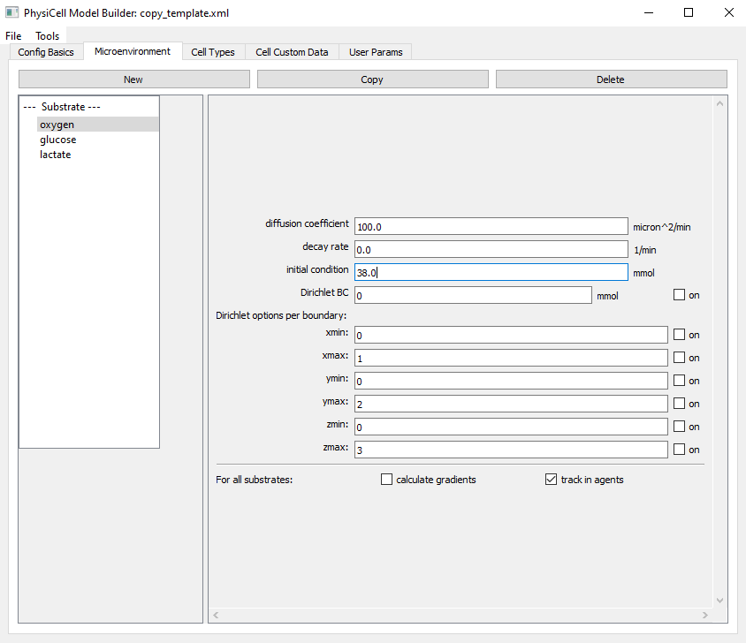
Demo Model
Oxygen
Diffusion Coefficient = 100.0 micron^2/min
Decay Rate = 0.0 1/min
Initial condition = 38.0 mmHg
Dirichlet = OFF
Track in agents = ON

Slide 50
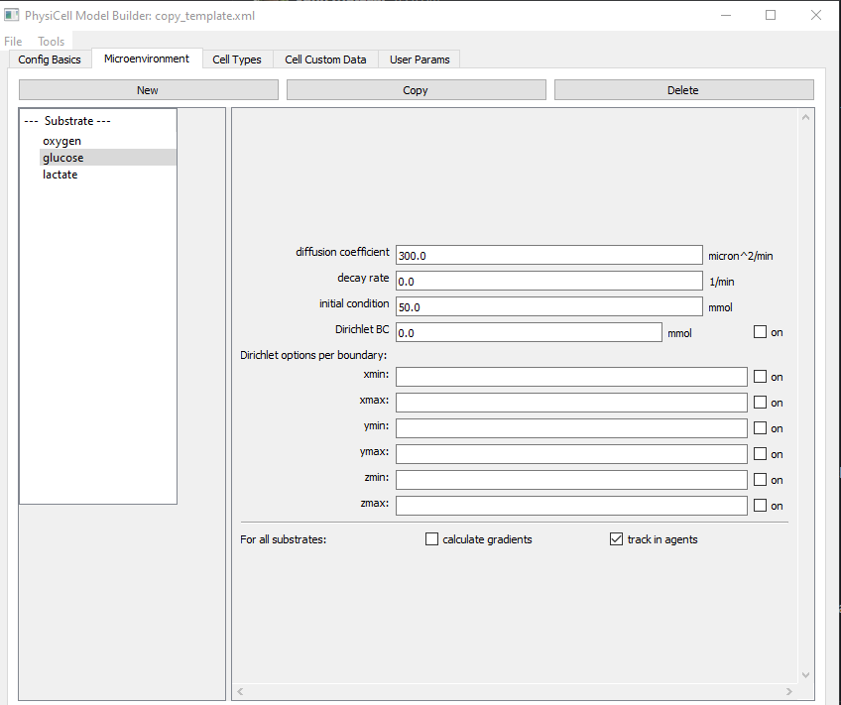
Demo Model
Glucose
Diffusion Coefficient = 300.0 micron^2/min
Decay Rate = 0.0 1/min
Initial condition = 50.0 a.u
Dirichlet = OFF
Track in agents = ON

Slide 51
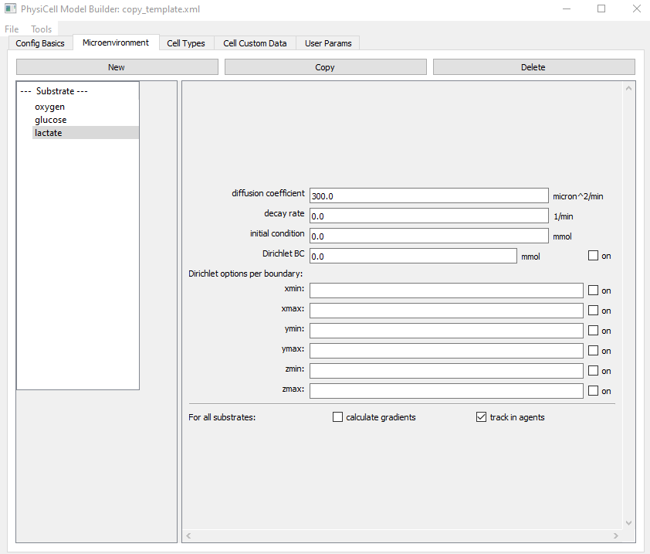
Demo Model
Lactate
Diffusion Coefficient = 300.0 micron^2/min
Decay Rate = 0.0 1/min
Initial condition = 0.0 mmHg
Dirichlet = OFF
Track in agents = ON

Slide 52
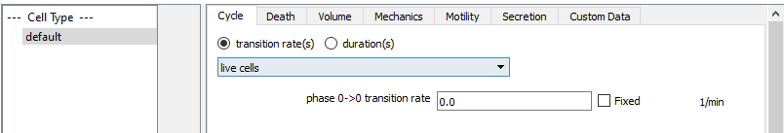
Cell Type
Only one type of cell in the name of “default”
Cycle
Live Cells
Transition rate(s)
0.0

Slide 53
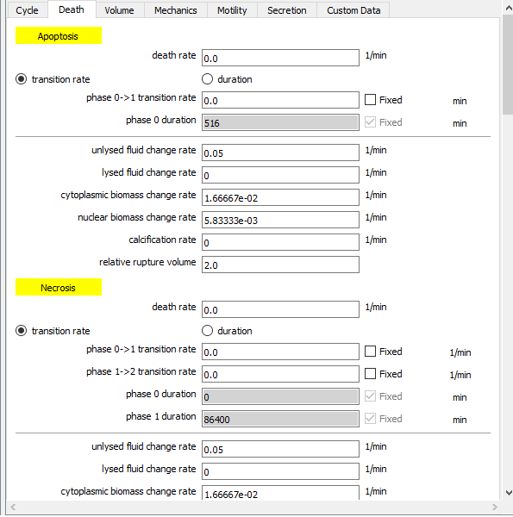
Cell Type
No Death

Slide 54
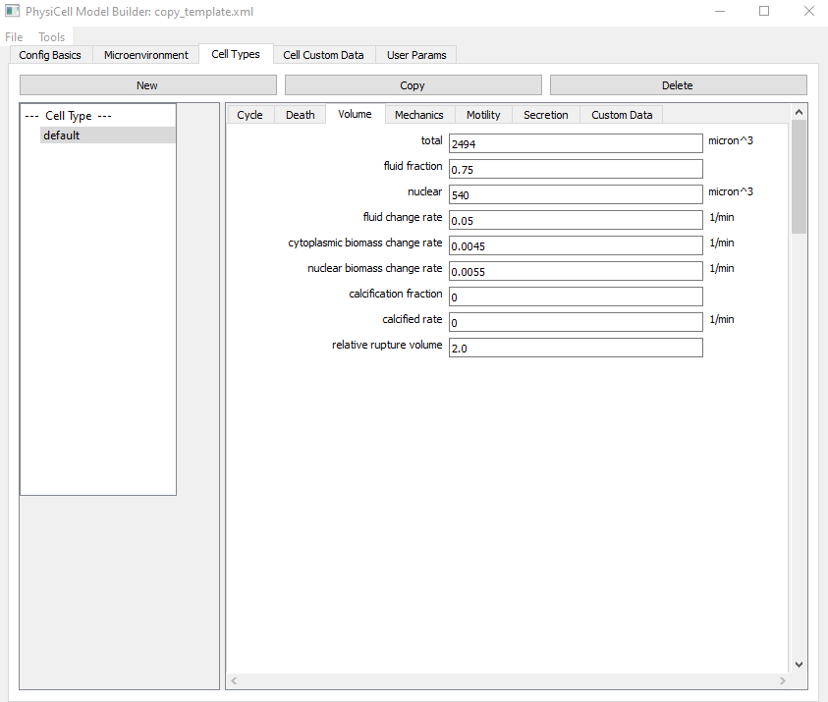
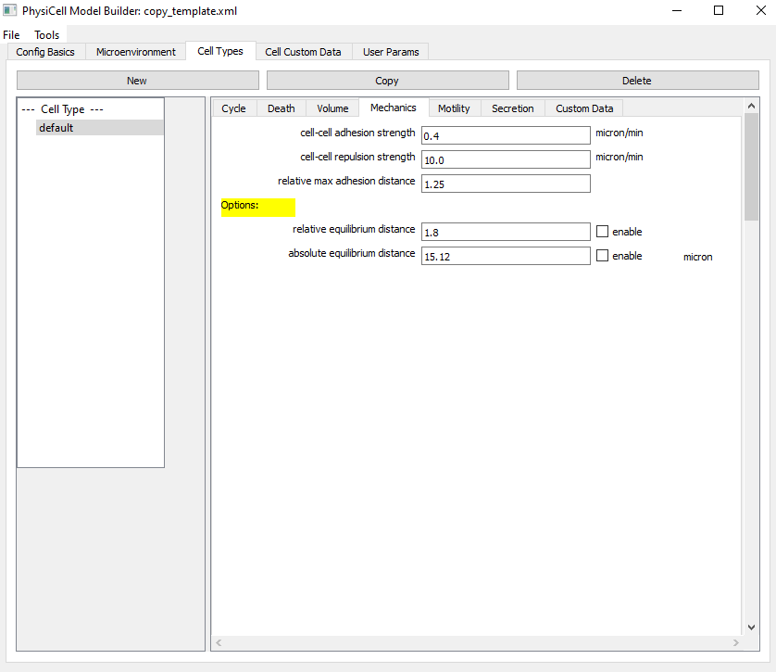
Cell Type
No change in the Volume and Mechanics Tab

Slide 55
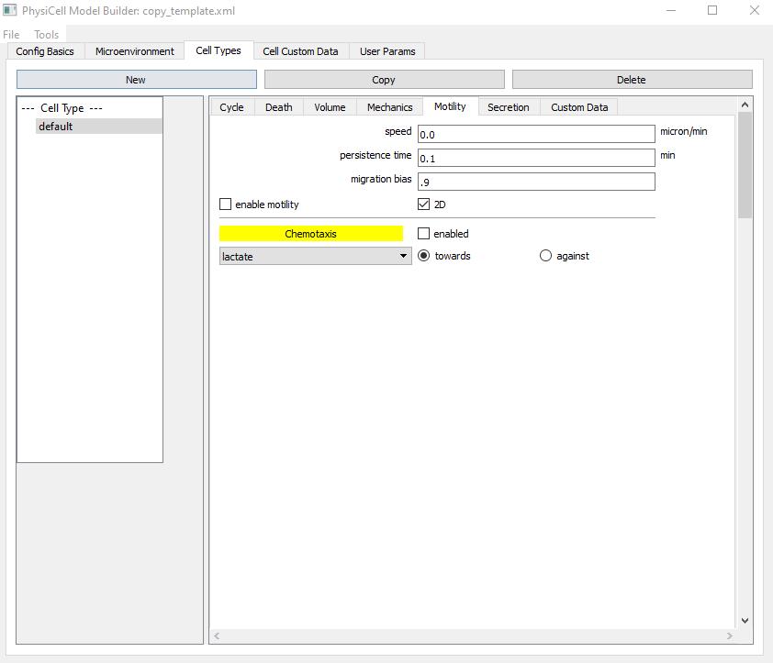
Cell Type
Motility
Speed = 0.0
Persistence Time = 0.1
Migration Bias = 0.9
Enable-motility

Slide 56
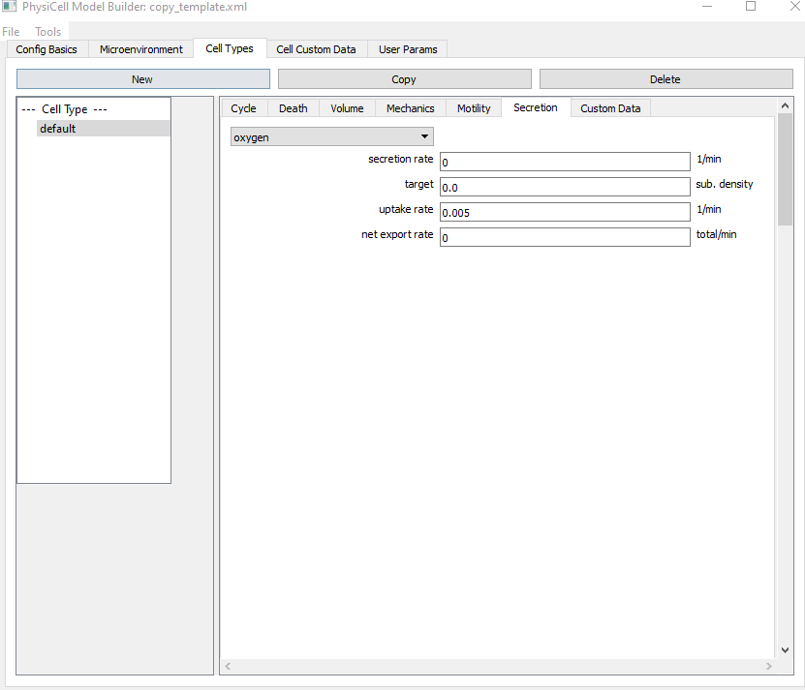
Cell Type : Secretion
Oxygen Tab
Uptake rate = 0.005

Slide 57
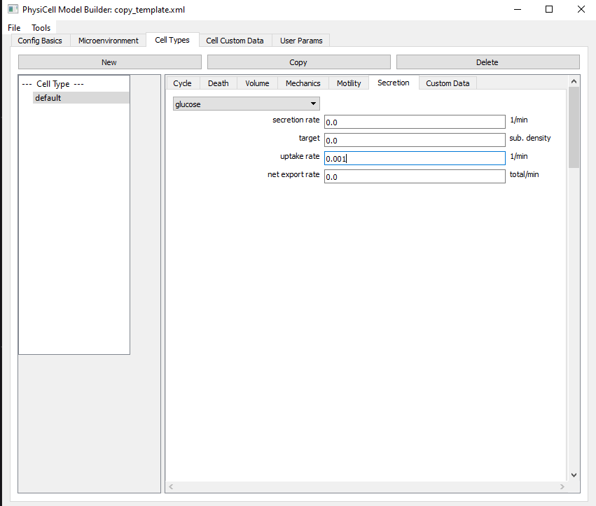
Cell Type : Secretion
Glucose Tab
Uptake rate = 0.001

Slide 58
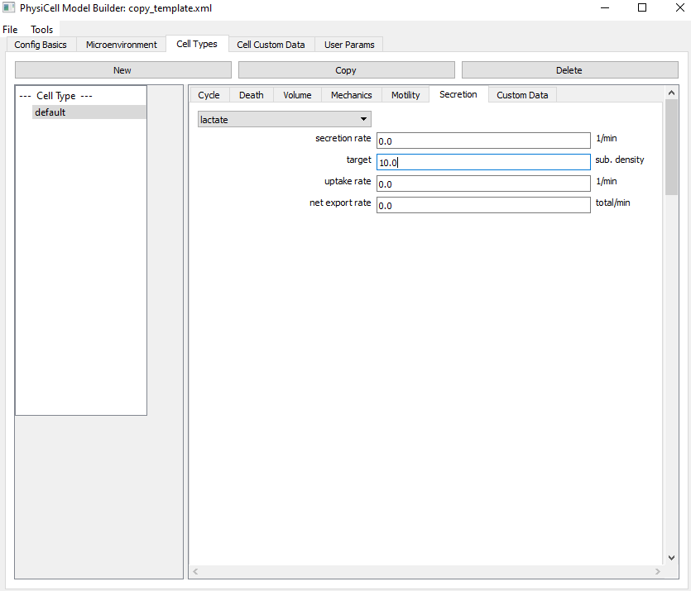
Cell Type : Secretion
Lactate Tab
Secretion Target = 10.0

Slide 59
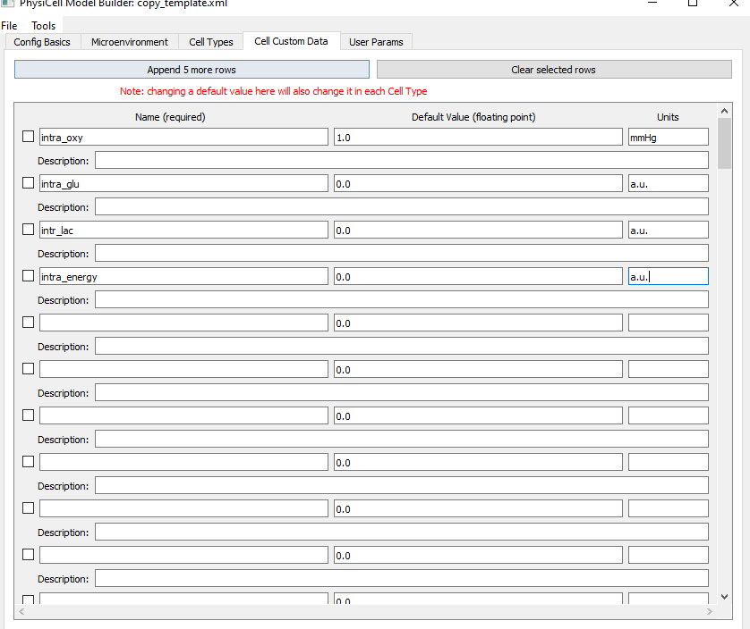
Cell Custom Data
We need to create intracellular data to save the data
intra_oxy = 0.0
intra_glu = 0.0
intra_lac = 0.0
intra_energy = 0.0

Slide 60
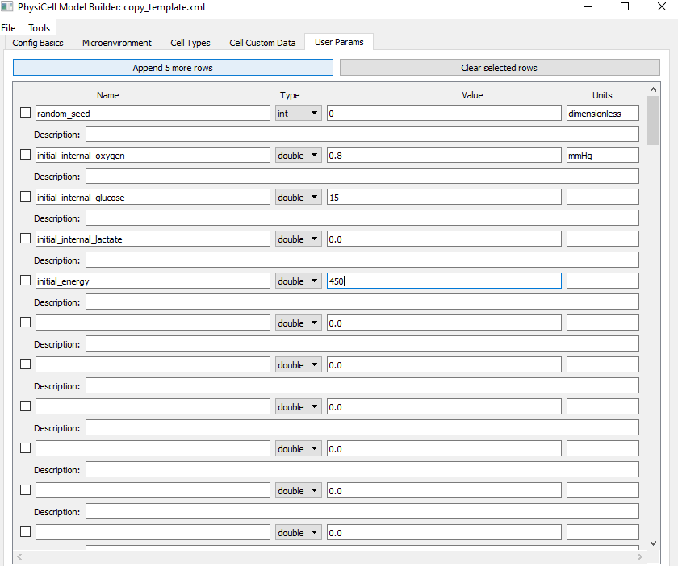
User Params
initial_internal_oxygen (double) = 0.8
initial_internal_glucose (double) = 15
initial_internal_lactate (double) = 0.0
initial_energy (double) =450

Slide 61
Save
Let’s look is it right.
In my case, it did not put cell custom data
I went to custom data in cell types tab
And just make them 0.0
Saved again.
It worked!

Slide 62
Let’s Add Intracellular Attribute
<intracellular type="roadrunner">
<sbml_filename>./config/Toy_Metabolic_Model.xml</sbml_filename>
<map PC_substrate="oxygen" sbml_species="Oxygen"></map >
<map PC_substrate="lactate" sbml_species="Lactate"></map >
<map PC_substrate="glucose" sbml_species="Glucose"></map >
<map PC_phenotype="da" sbml_species="apoptosis_rate"></map>
<map PC_phenotype="mms" sbml_species="migration_speed"></map>
<map PC_phenotype="ssr_lactate" sbml_species="Lac_Secretion_Rate"></map>
<map PC_phenotype="ctr_0_0" sbml_species="Transition_Rate"></map>
</intracellular>

Slide 63




Funding Acknowledgements
PhysiCell Development:
Breast Cancer Research Foundation
Jayne Koskinas Ted Giovanis Foundation for Health and Policy
National Cancer Institute (U01CA232137)
National Science Foundation (1720625)
Training Materials:
Administrative supplement to NCI U01CA232137 (Year 2)

